Slide 1










Mock Project KickOff Deck
MEDICATION ERROR-EFFECTS DATASET
GROUP 3:
Nikki Wagholikar
Nishant Jain
Abhishek Choure
Oendree Das
© Copyright 2022

Slide 2
OUTLINE
Introduction
Data Dictionary
ETL
Data Modeling
Dashboarding

Slide 3

01
INTRODUCTION

Slide 4
INTRODUCTION
Task Performed:
Understood the data and performed ETL using suitable tool
Identified facts and dimensions and performed data modeling
Dashboarding and story building
Generated insights
Technologies Used:
IICS
PowerBI
Snowflake
Python
SQL

Slide 5
02
Data Dictionary

Slide 6
Demorgaphics_data_2015.csv
COLUMN NAME | DESCRIPTION
primaryid | The number that uniquely identifies an AERS report. Primary link field between data files.
caseid | Unique Id for every case
Event Date | Date the adverse event occurred or began. (YYYYMMDD format). If a complete date is not available, a partial date is provided.
Manufacture Received Date | Date manufacturer first received initial information. In subsequent versions of a case, the latest manufacturer received date will be provided (YYYYMMDD format). If a complete date is not available, a partial date will be provided. See the NOTE on dates at the end

Slide 7
COLUMN NAME | DESCRIPTION
Init Fda Dt | Init Fda Dt
FDA Received Date | Date FDA received Case. In subsequent versions of a case, the latest manufacturer received date will be provided (YYYYMMDD format).
Report Type | Code for the type of report submitted. "EXP" means expedited (15 day), "PER" is periodic, and "DIR" is direct.
Manufacturer Number | Manufacturer's unique report identifier.
Manufacturer Filing Report | Coded name of manufacturer sending report; if not found, then verbatim name of organization

Slide 8
COLUMN NAME | DESCRIPTION
Patient's Age | Numeric value of patient's age at event
Patient's Age Unit | Unit abbreviation for patient's age. "DEC" is decade, "YR" is year, "MON" is month, "WK" is week, "DY" is day, and "HR" is hour.
Sex | Gender
E-Submission | Indicates whether (Y/N) this report was submitted under the electronic submissions procedure for manufacturers.
Patient's Weight | Weight. Numeric value of patient's weight.
Patient's Weight Unit | Unit abbreviation for patient's weight. "KG" is kilograms, "LBS" is pounds, and "GMS" is grams.

Slide 9
Report Date | Date report was sent (YYYYMMDD format). If a complete date is not available, a partial date is provided.
Occupation Code | Abbreviation for the reporter's type of occupation in the latest version of a case. "MD" is physician, "PH" is pharmacist, "OT" is other health professional, "LW" is lawyer, and "CN" is consumer.
Reporter Country | Country
Occurrence Country | Country where it occurred
Serialid | Serialid

Slide 10
DrugInformation_data_2015.csv
COLUMN NAME | DESCRIPTION
Isr | Number that uniquely identifies an AERS report. Primary link field between data files.
Drug Sequence No. | Unique number for identifying a drug for a case. This field can be used as a primary link between different tables within this dataset.
Drug Role | Code for drug's reported role in event. "PS" is primary suspect drug, "SS" is secondary suspect drug, "C" is concomitant, and "I" is interacting.
Drug Name | Name of medicinal product. If a "Valid Trade Name" is populated for this case, then Drug Name = Valid Trade Name; if not, then Drug Name = "Verbatim" name, exactly as entered on the report. For the great majority of reports, there is a "Valid Trade Name."

Slide 11
COLUMN NAME | DESCRIPTION
Validated/Verbatim Name | "1" indicates that a validated trade name is used for the drug name and "2" indicates that a verbatim name is used.
Route | The route of drug administration.
Dose | Verbatim text for dose, frequency, and route, exactly as entered on report.
Rechallenge | Rechallenge code, indicating if reaction recurred when drug therapy was restarted. "Y" is positive rechallenge, "N" is negative rechallenge, "U" is unknown, and "D" does not apply.
SerialId | Serialid

Slide 12
DrugTherapyDuration_data_2015.csv
COLUMN NAME | DESCRIPTION
ISR - PRIMARY KEY | The number that uniquely identifies an AERS report. Primary link field between data files.
caseid | Unique Id for every case
Drug Sequence | Drug Sequence Number
Start Date | Date therapy was started (or re-started) for this drug (YYYYMMDD) If a complete date not available, a partial date is provided.
End Date | Date therapy was stopped for this drug. (YYYYMMDD) If a complete date not available, a partial date will be provided.
Serialid | Serialid

Slide 13
EventTerms_data_2015.csv
COLUMN NAME | DESCRIPTION
primaryid | The number that uniquely identifies an AERS report. Primary link field between data files.
caseid | Unique Id for every case
Preferred Term(PT) | Preferred Term" level medical terminology describing the event, using the Medical Dictionary for Regulatory Activities (MedDRA). The order of the terms for a given event does not imply priority. In other words, the first term listed is not necessarily considered more significant than the last one listed.
Serialid | Serialid

Slide 14
PatientOutcomes_data_2015.csv
COLUMN NAME | DESCRIPTION
primaryid | The number that uniquely identifies an AERS report. Primary link field between data files.
caseid | Unique Id for every case
outc_cod | Outcome code
Serialid | Serialid
outc_cod_description | Outcome Code Definition. DE, Death | LT, Life-Threatening | HO, Hospitalization - Initial or Prolonged | DS, Disability | CA, Congenital Anomaly | RI, Required Intervention to Prevent Permanent Impairment/Damage | OT, Other

Slide 15
PreferredTermIndicators_data_2015.csv
COLUMN NAME | DESCRIPTION
primaryid | The number that uniquely identifies an AERS report. Primary link field between data files.
caseid | Unique Id for every case
indi_drug_seq | The drug sequence number for identifying a drug for an ISR
indi_pt | “Preferred Term" level medical terminology describing the indication for use, using the

Slide 16
ReportSources_data_2015.csv
COLUMN NAME | DESCRIPTION
primary_id | The number that uniquely identifies an AERS report. Primary link field between data files.
caseid | Unique Id for every case
rpsr_code | Report Source Code Definition. FGN, Foreign | SDY, Study | LIT, Literature | CSM, Consumer | HP, Health Professional | UF, User Facility | CR, Company Representative | DT, Distributor | OTH, Other
serialid | serialid

Slide 17
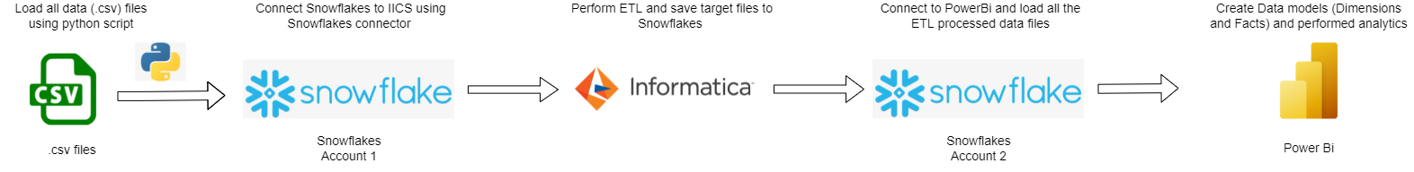
Architecture

Slide 18
03
ETL
IICS
-

Slide 19
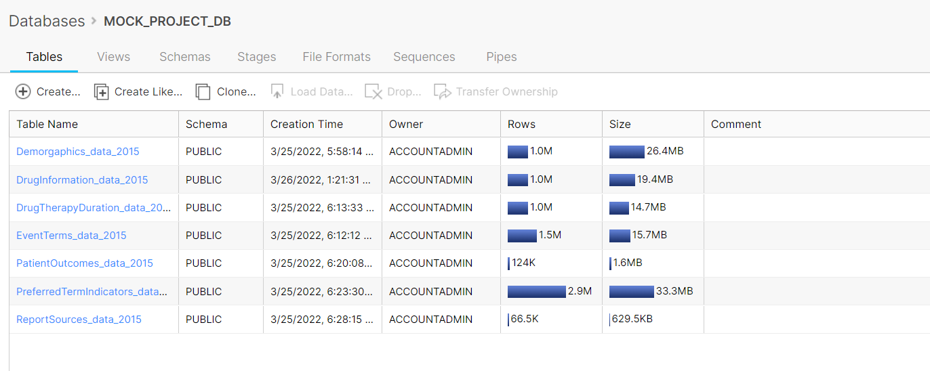
Data warehouse - Snowflake
Source

Slide 20
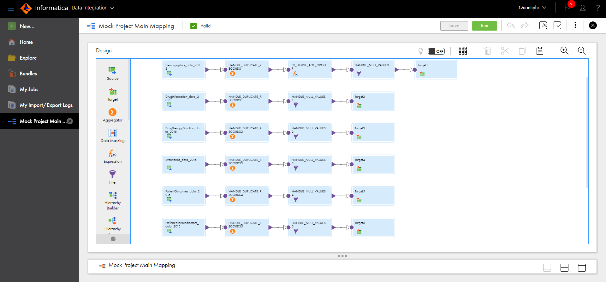
Mapping

Slide 21
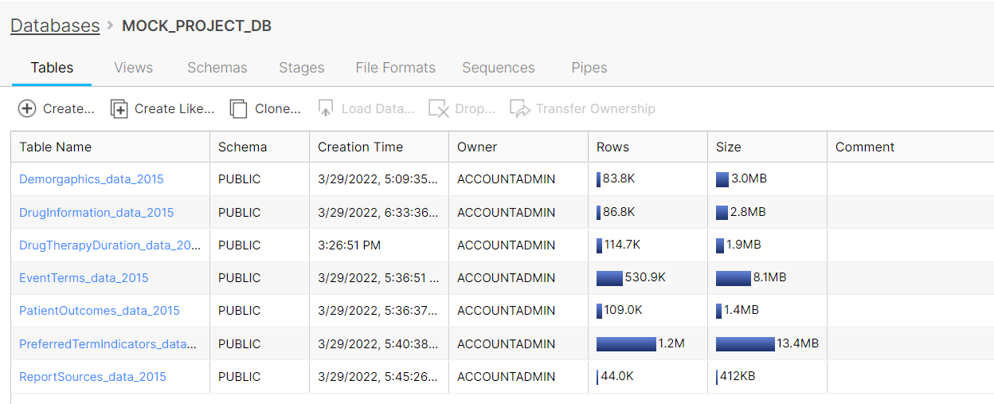
Data warehouse - Snowflake
Target

Slide 22
04
DATA MODELLING
Dimensions - Facts

Slide 23
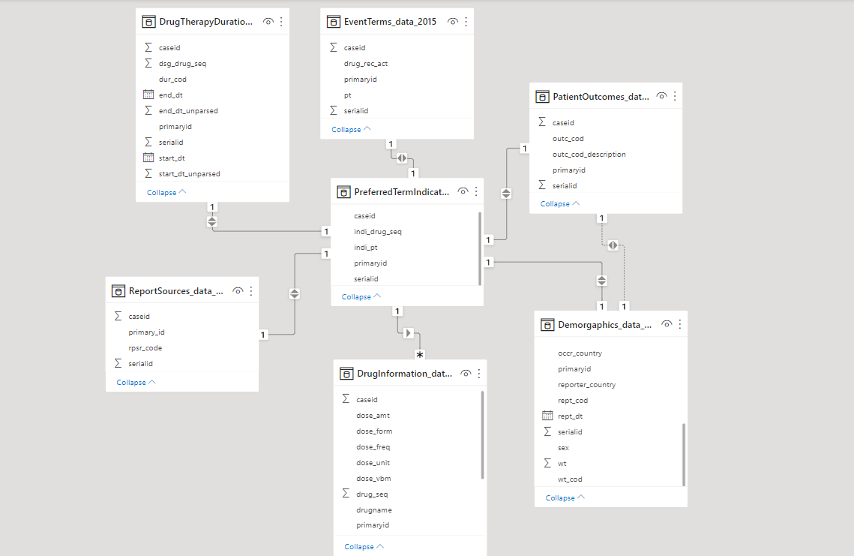
MEDICATION ERROR-EFFECTS DATA MODEL

Slide 24
Dimensions and Fact Tables
Dimension Tables :
Demorgaphics_data_2015
DrugInformation_data_2015
ReportSources_data_2015
Fact Tables :
DrugTherapyDuration_data_2015
EventTerms_data_2015
PatientOutcomes_data_2015
PreferredTermIndicator_data_2015

Slide 25
05
DASHBOARDING

Slide 26
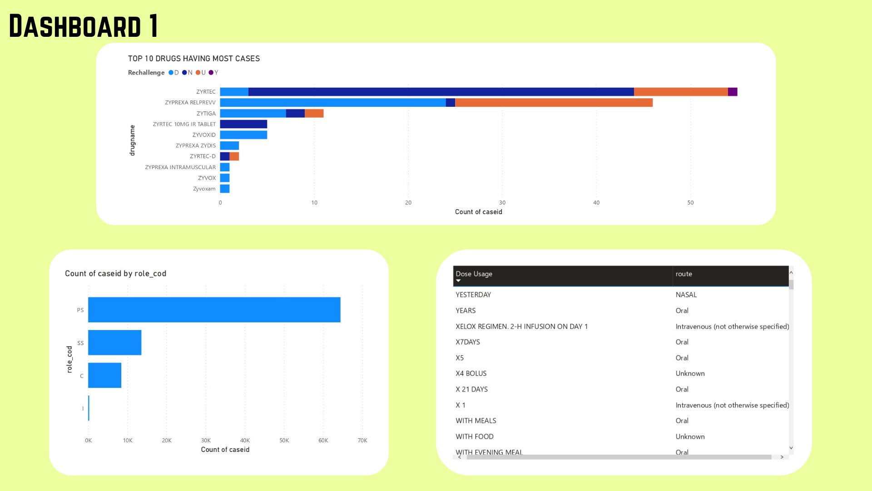
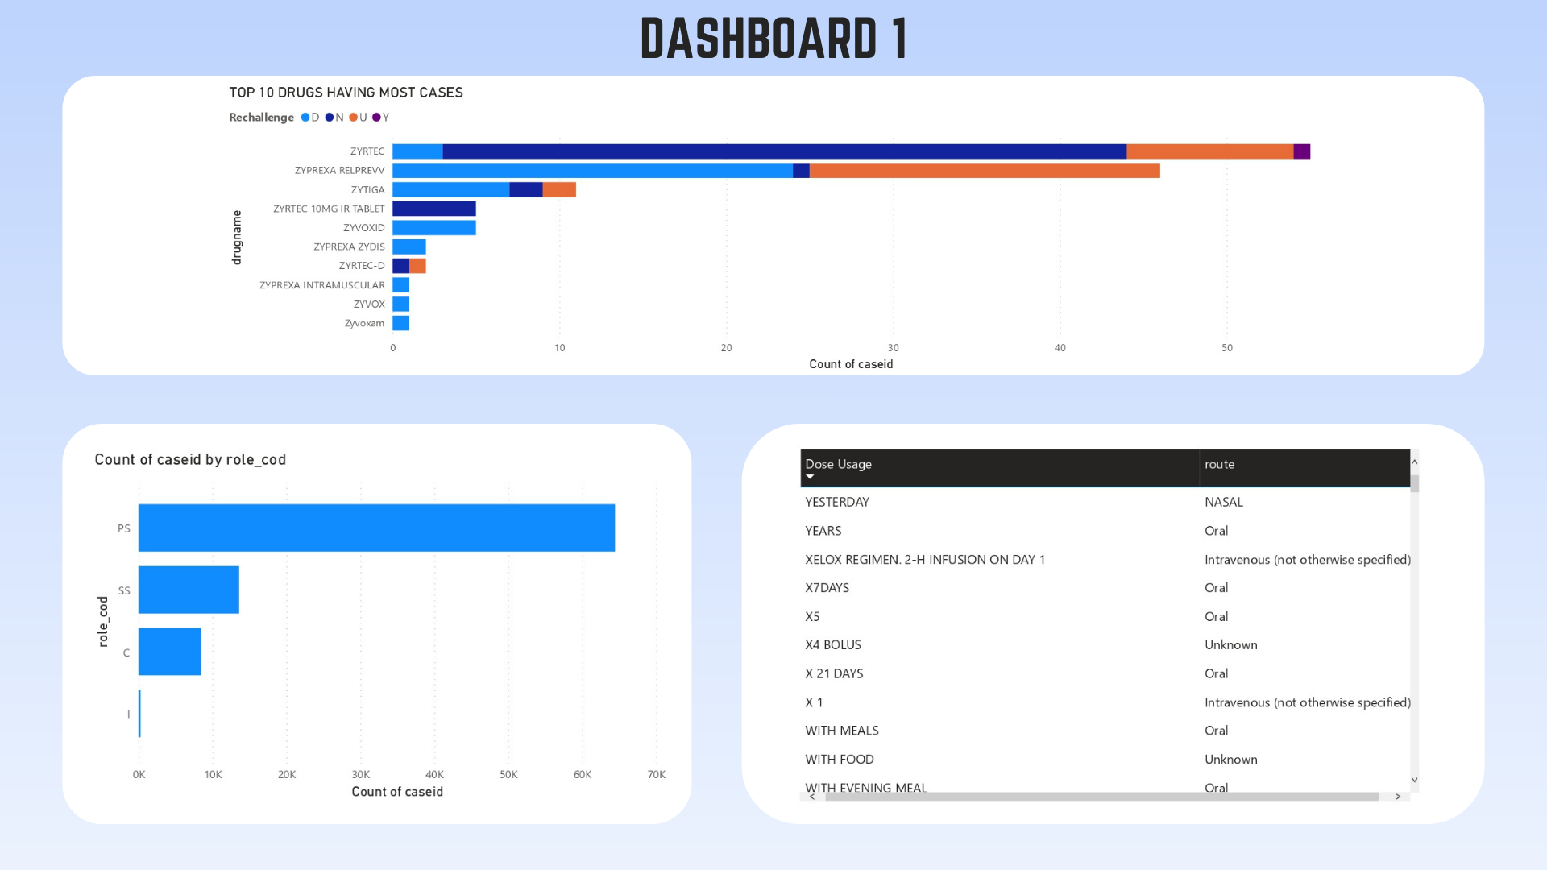

Slide 27
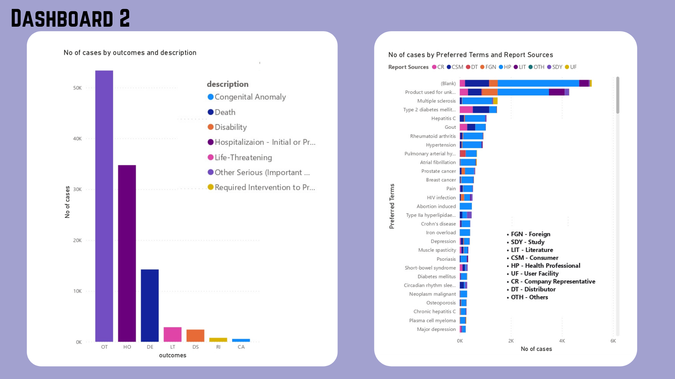
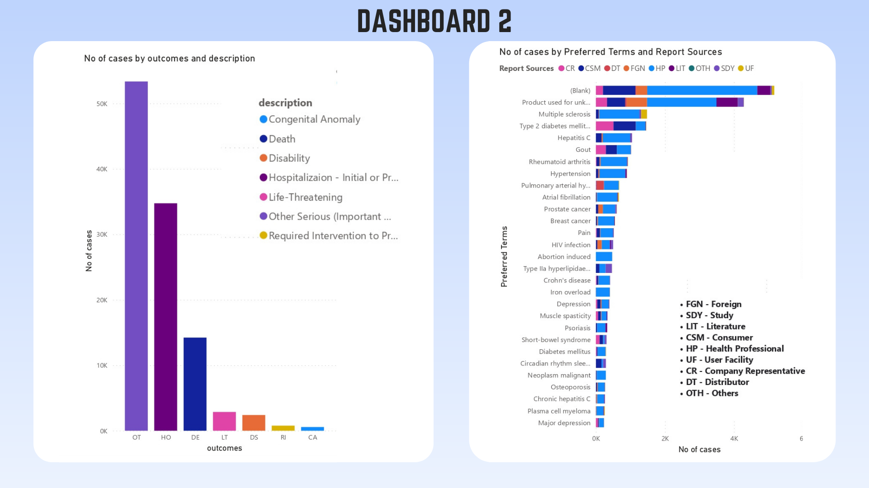

Slide 28
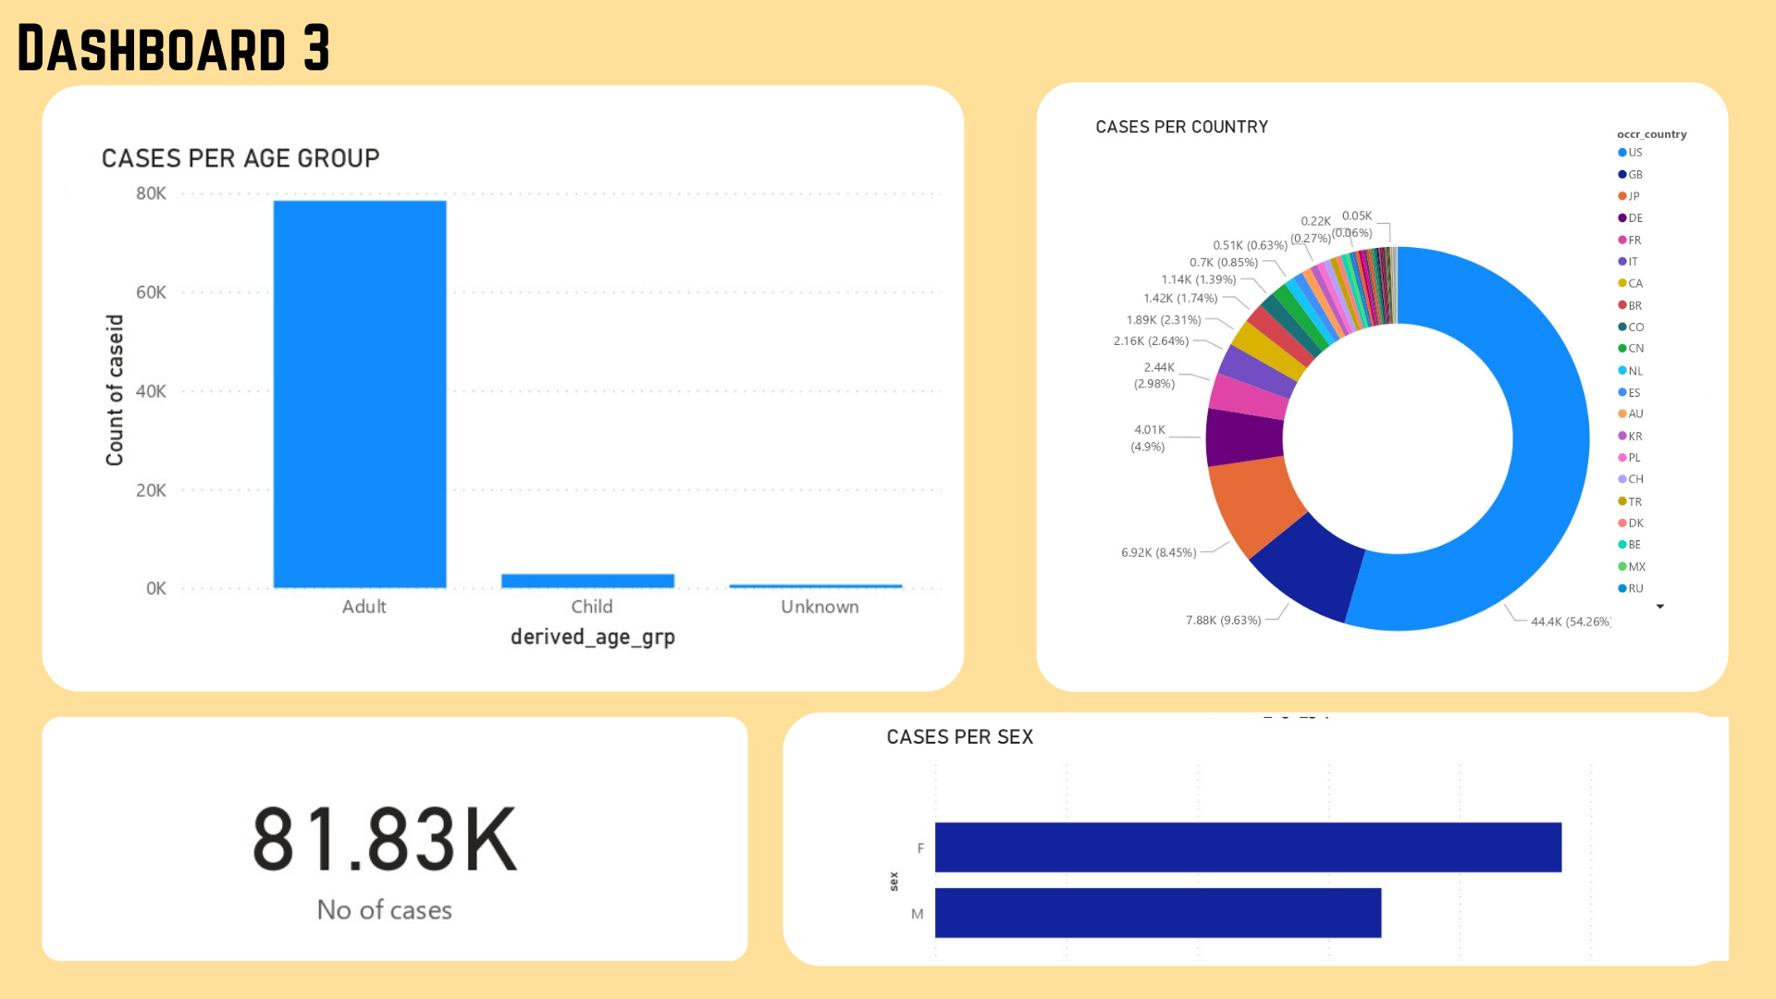
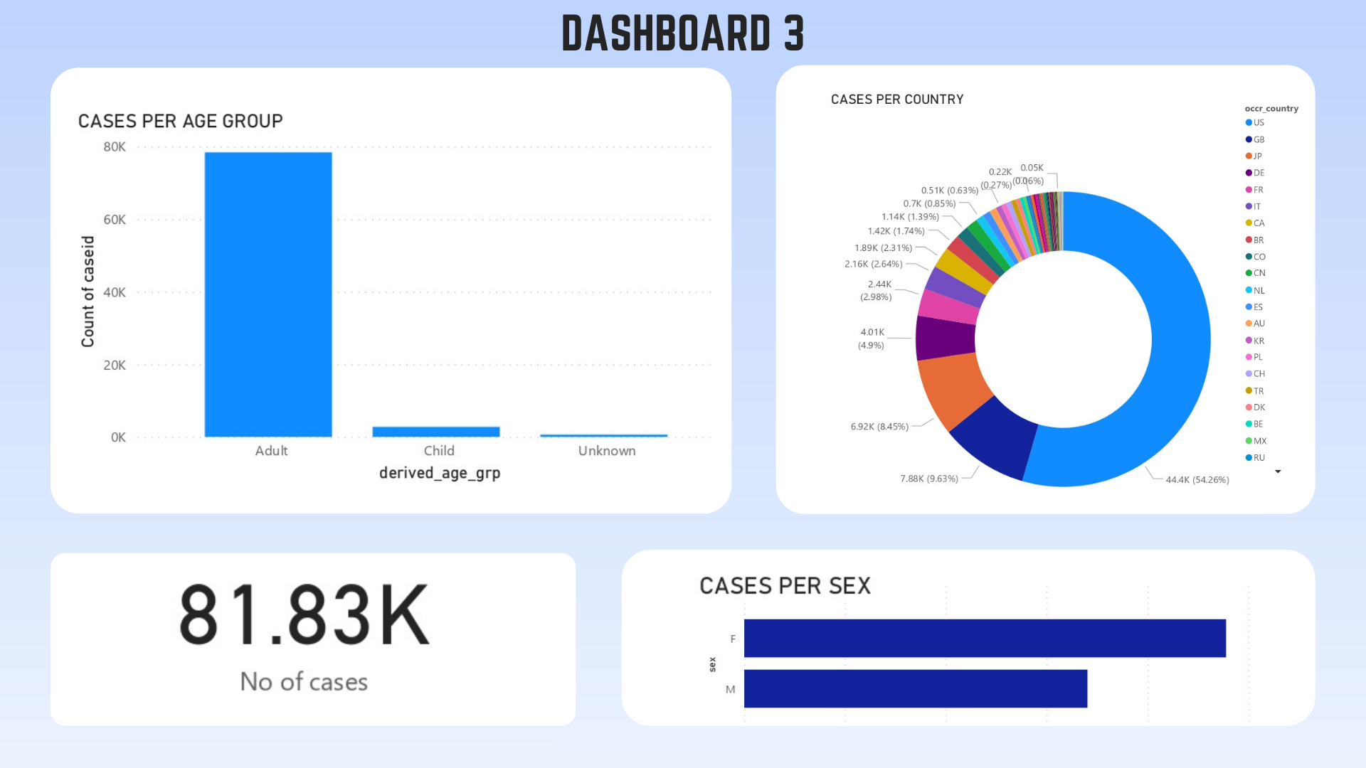

Slide 29
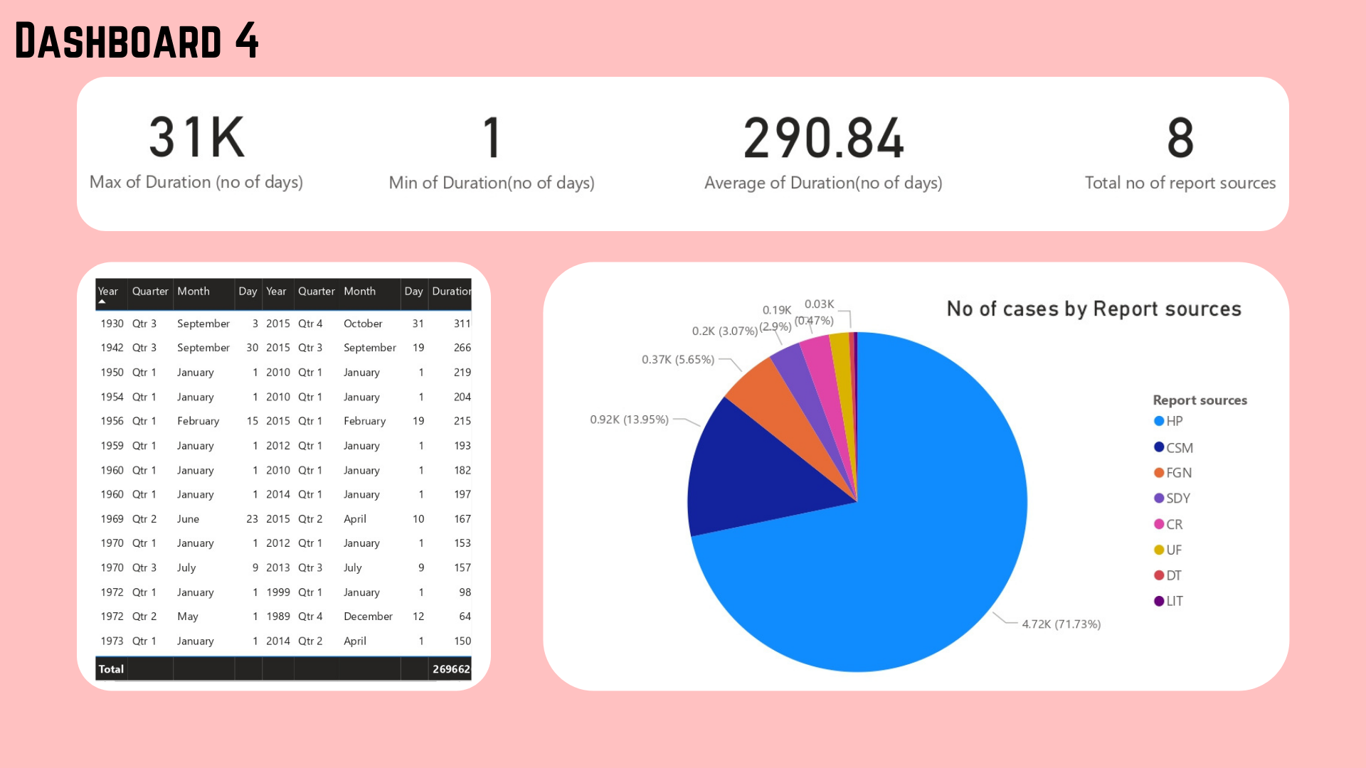
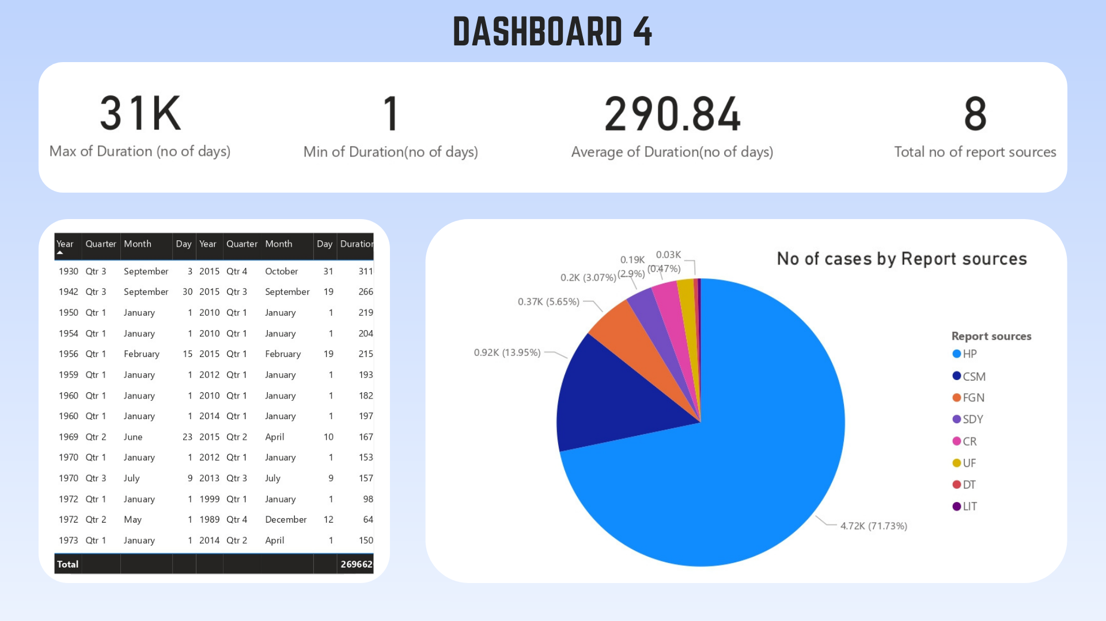

Slide 30





Thank You
Follow us on:

